Slide 1

Web Development Learning Journey
This presentation outlines a structured roadmap for learning front-end web development, from fundamentals to building a complete responsive website.

Slide 2
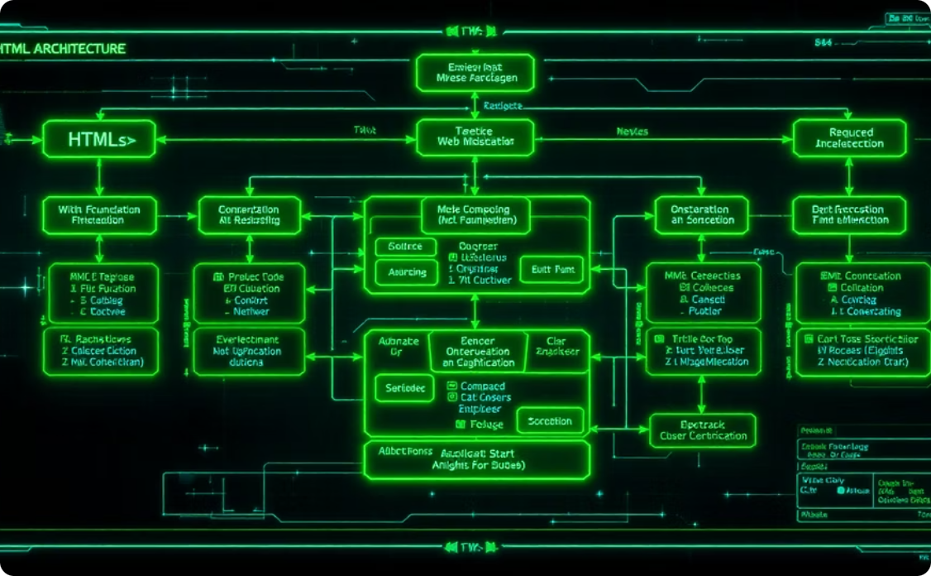
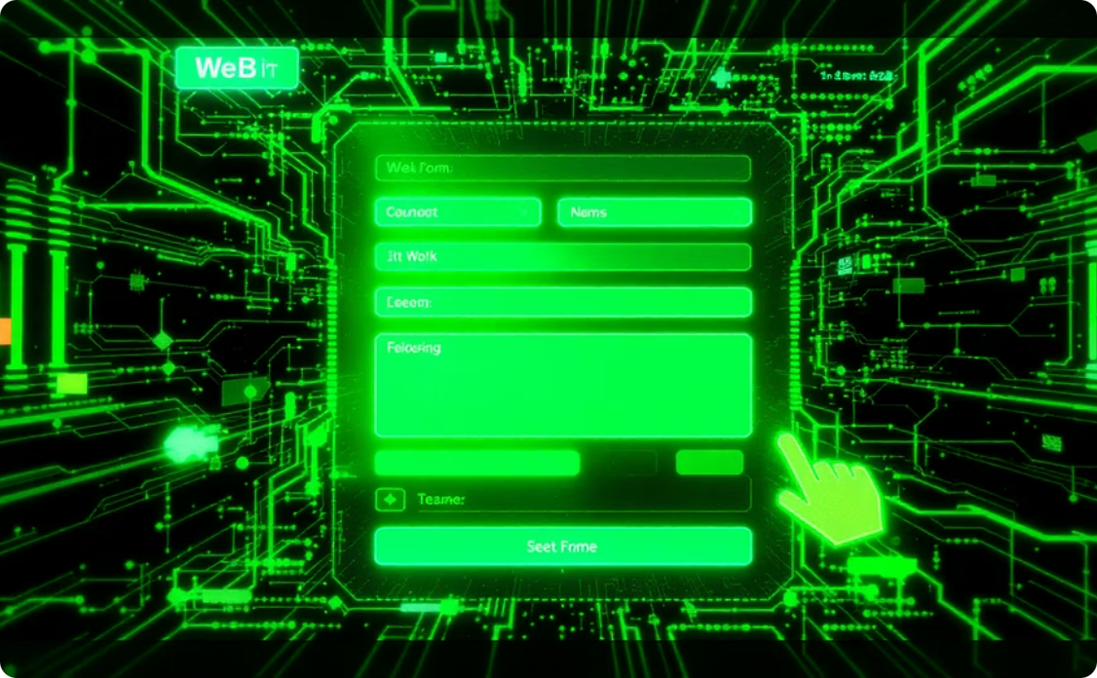
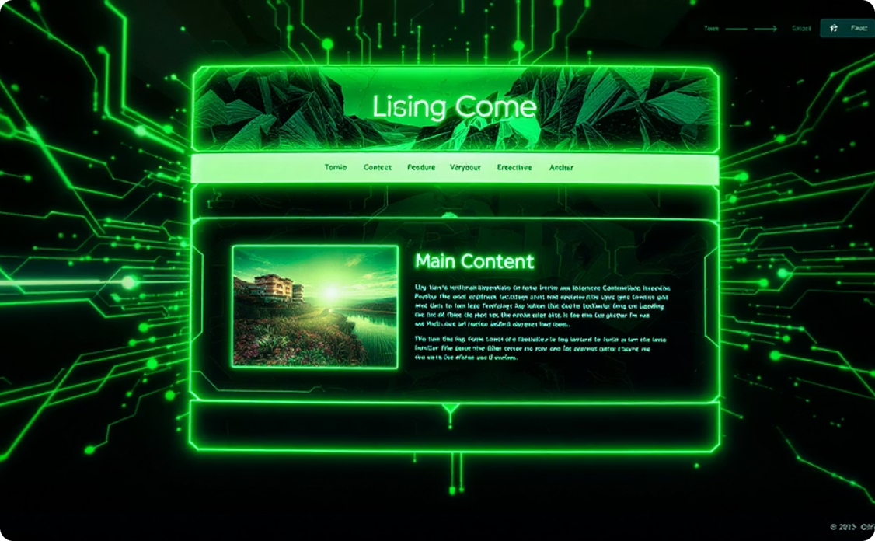

HTML Essentials: Laying the Web's Foundation
Core HTML Elements
Building Interactive Forms
Structuring Content with Semantic HTML
Master fundamental HTML tags like <div>, <p>, <img> to build the core structure of web pages.
Construct user-friendly web forms using diverse input types, labels, and buttons for interactive experiences.
Enhance content structure and meaning with semantic HTML tags like <header>, <nav>, <article>, and <footer>.
Assignment: Personal Bio Webpage
Create a personal bio webpage with a semantic structure and a working contact form, incorporating headings, paragraphs, images, and links.

Slide 3
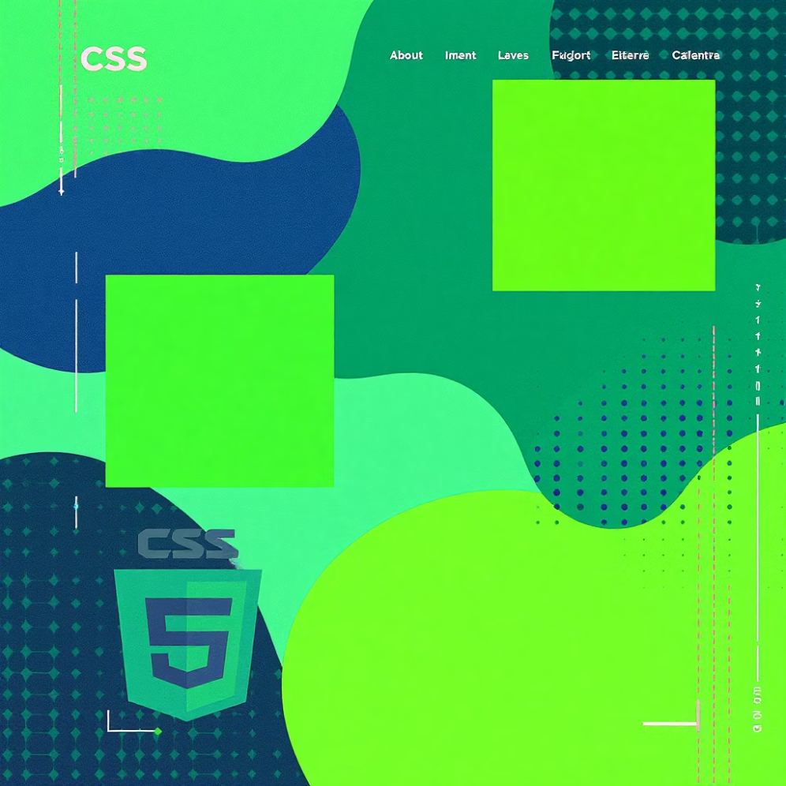

CSS Fundamentals: Styling Your Creations
Key Concepts:
CSS Selectors (Class, ID, Pseudo-selectors)
Understanding the Box Model
Flexbox for Layouts
Typography and Aesthetic Styling
Assignment: Styled Portfolio Layout
Design a styled portfolio layout using Flexbox, featuring About, Skills, and Projects sections, with custom fonts, spacing, and styling.

Slide 4




Advanced CSS: Dynamic and Responsive Designs
Transitions & Animations
CSS Grid Layout
Pseudo-elements
Master advanced two-dimensional layouts for complex page structures.
Style specific parts of elements without adding new HTML, using ::before and ::after.
Add smooth visual effects and interactive elements to your webpages.
Assignment: Product Card Grid
Build a product card grid using CSS Grid, complete with captivating hover effects and smooth animations for enhanced interactivity.

Slide 5




Bootstrap: Accelerating Development
Bootstrap is a powerful framework that streamlines front-end development. It provides pre-built components and a responsive grid system.
Grid System
Components
Utilities
Quickly create responsive layouts with Bootstrap's intuitive grid.
Utilise pre-designed elements like Navbars, Cards, and Buttons.
Speed up styling with helper classes for spacing, colours, and more.
Assignment: Landing Page Recreation
Recreate a responsive landing page (e.g., Startup, E-commerce, or Portfolio) using Bootstrap's grid, components, and utility classes.

Slide 6
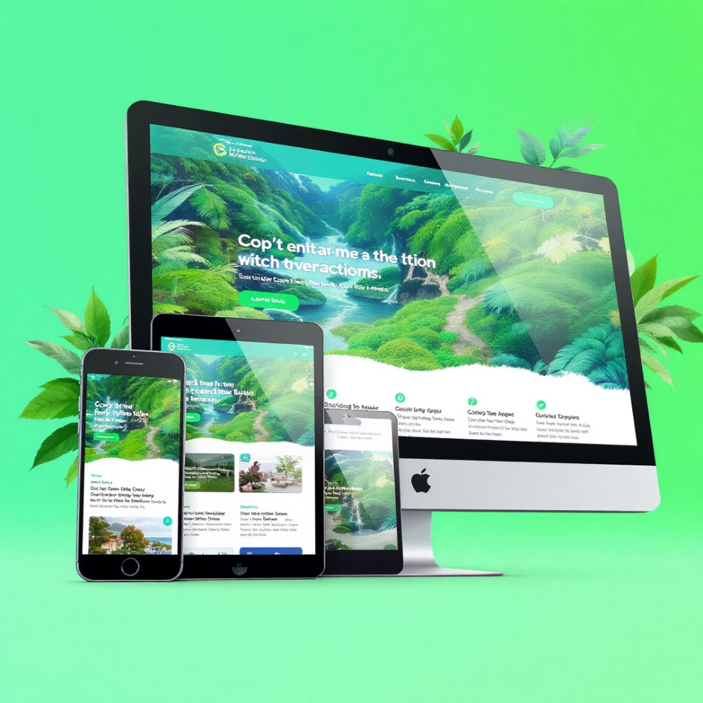

Responsive Design: Adapting to Every Device
Mobile-first approach: Design for smaller screens first, then scale up.
Media Queries: Apply specific styles for different screen sizes and devices.
Accessibility considerations: Ensure your site is usable by everyone, focusing on alt text, colour contrast, and semantic roles.
Responsive design ensures an optimal viewing and interaction experience across a wide range of devices, from desktops to mobile phones.
Assignment: Responsive Landing Page Conversion
Convert your Bootstrap landing page into a fully responsive site, optimising its layout for mobile, tablet, and desktop, and testing across various screen sizes while incorporating accessibility considerations.

Slide 7
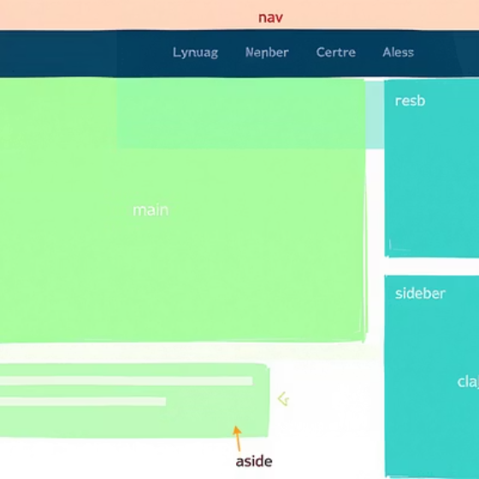
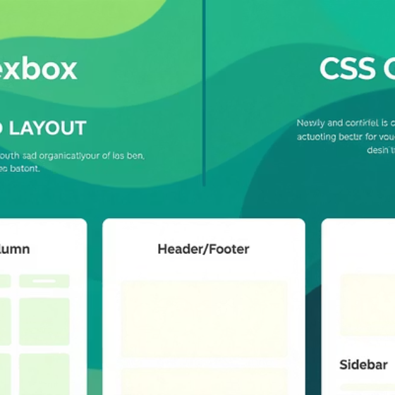
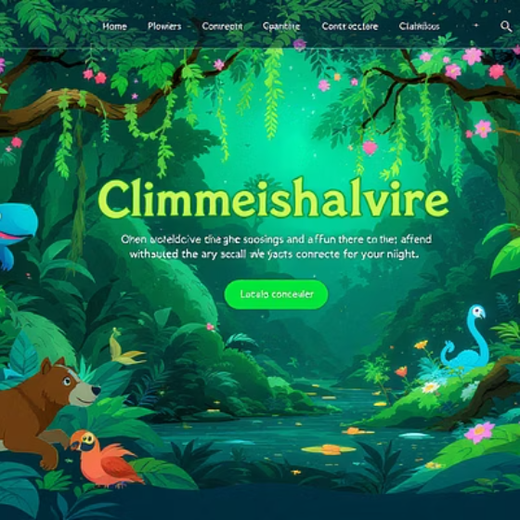
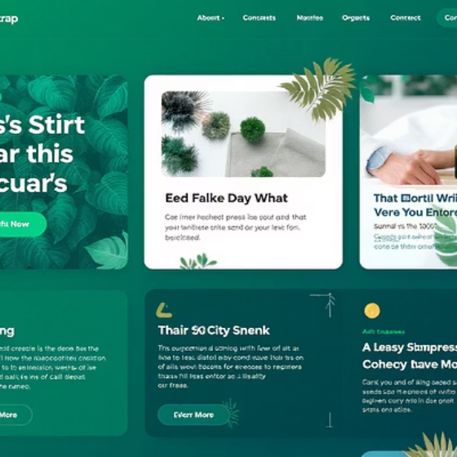
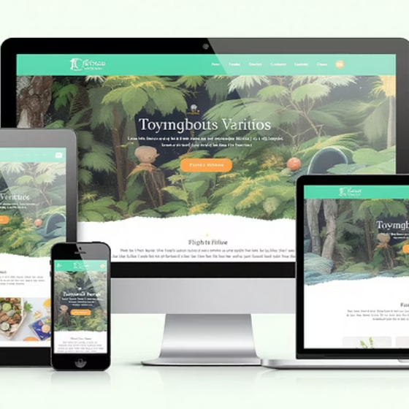
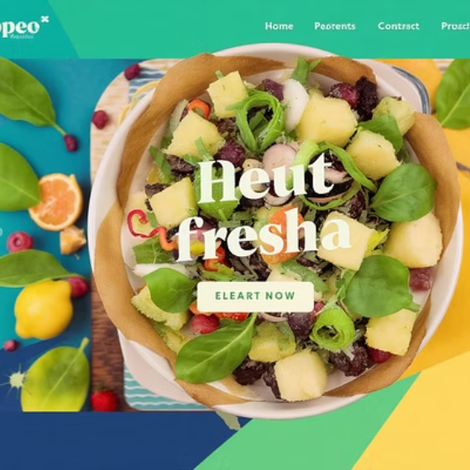

Final Project: Building a Complete Responsive Site
This culminating project integrates all the skills acquired throughout the learning journey. You'll build a real-world, fully functional responsive website.
Final Assignment: Full UI for a Fictional Product or Portfolio Site
Develop a complete website with semantic HTML, styled using Flexbox and CSS Grid, incorporating animations and Bootstrap components. The site must be fully responsive and accessible, with an optional live prototype or deployed version.

